Slide 1

Error Ellipses
Prototype 1

Slide 2
Interface and it’s logical flow Things that we shall be discussing
How the user will be able to navigate through the interface to plot error ellipses
How the user will be able to save the data

Slide 3
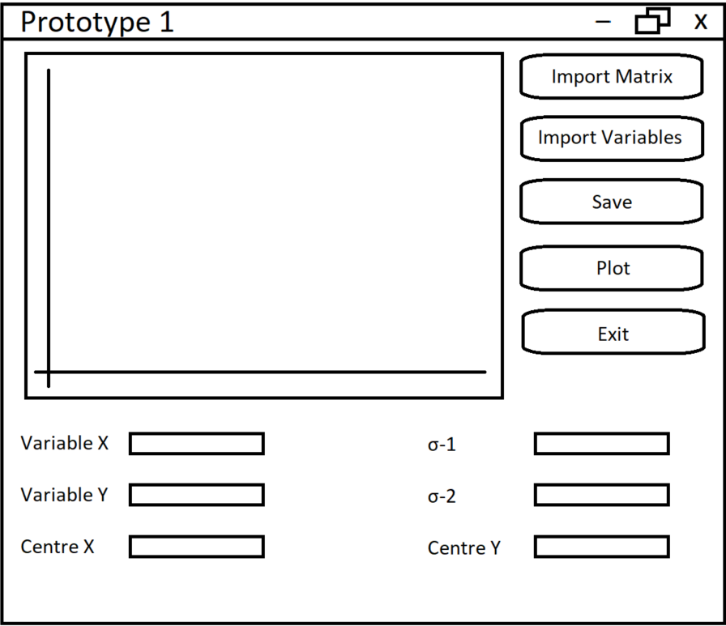
Interface
This is the main interface
User can:
Import covariance matrix
Import variables
Save the plotted data
Plot the data
Exit the program
Enter the parameter combinations for X and Y
Enter the centre for the ellipses
Enter confidence level

Slide 4
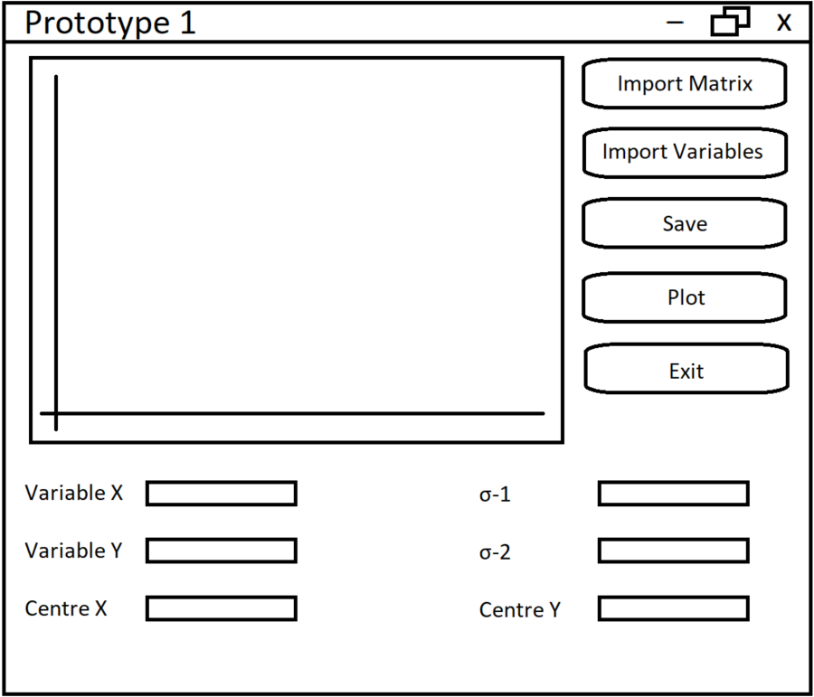
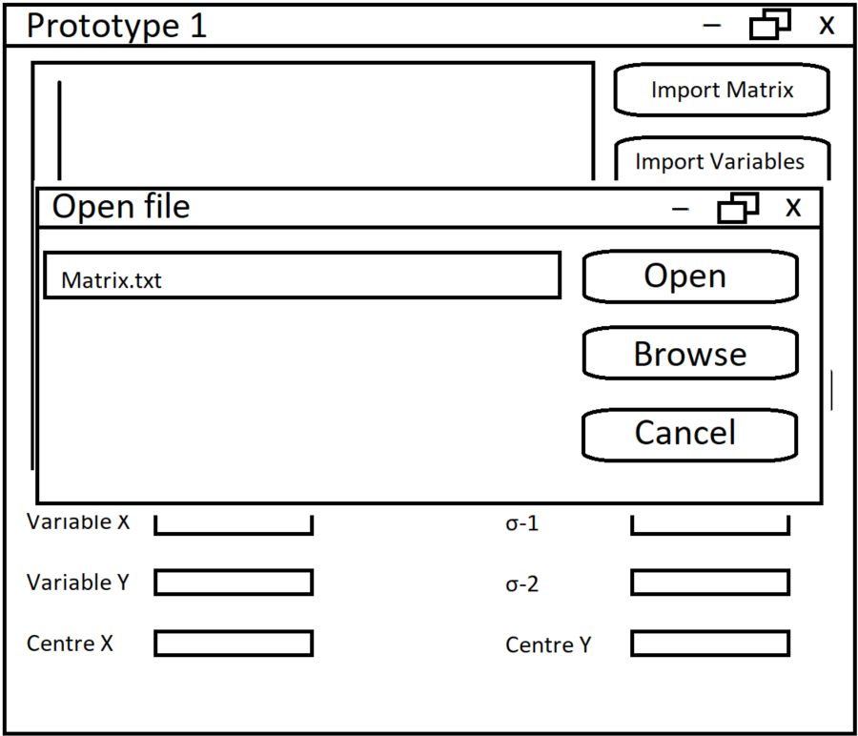

Importing the matrix

Slide 5

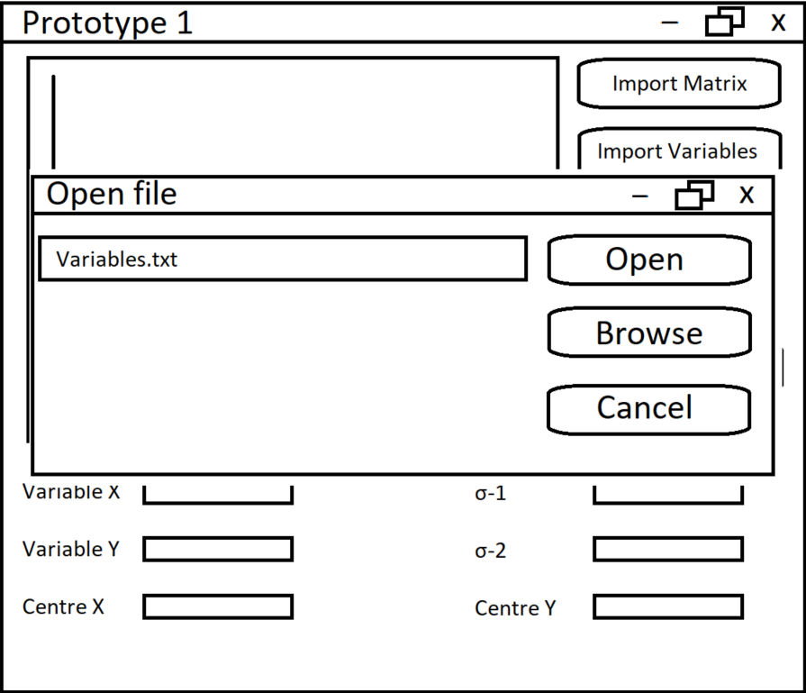
Importing the variables

Slide 6
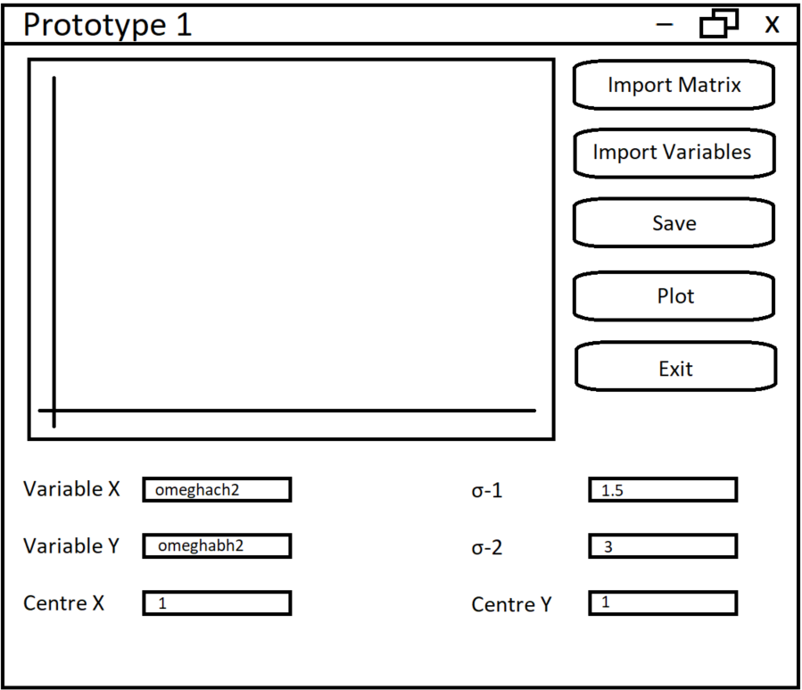
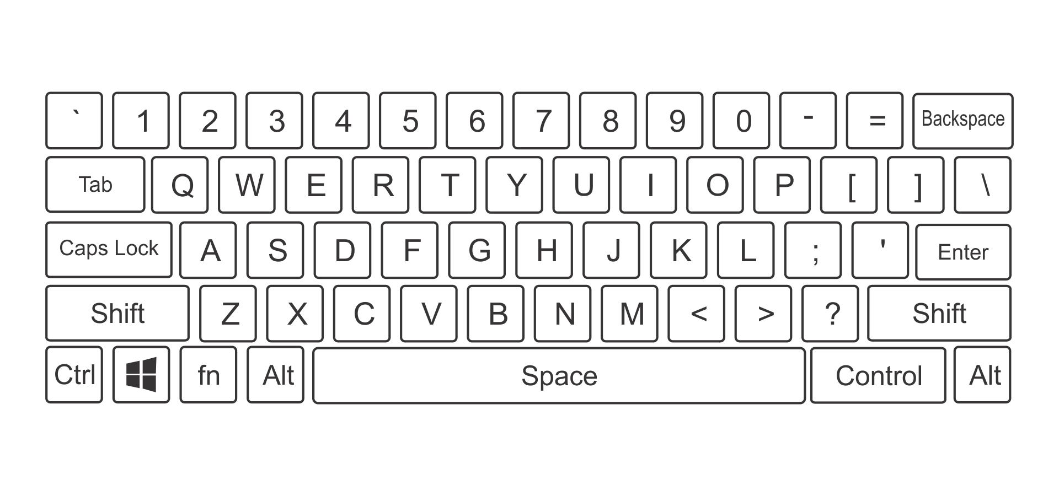
Setting the parameters

Slide 7
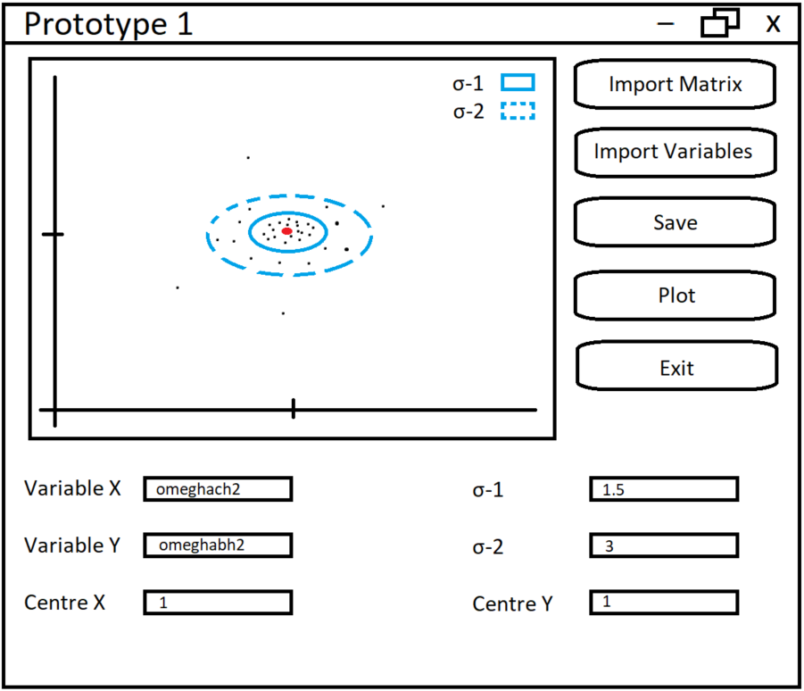
Plotting

Slide 8
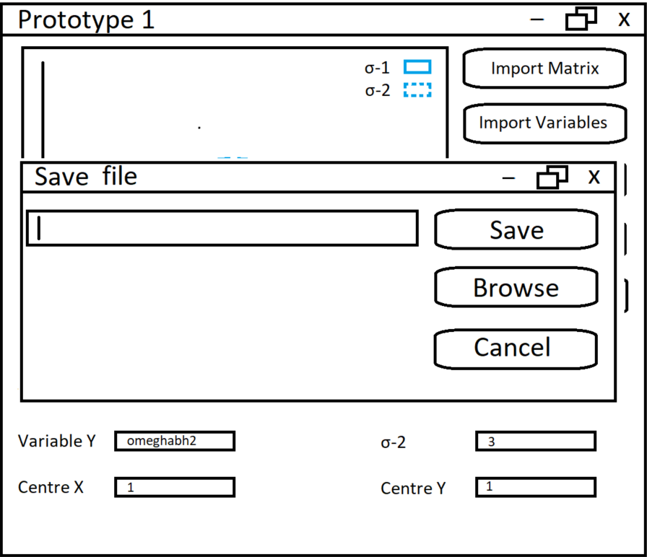
Saving

Slide 9
Exiting

Slide 10
Questions and suggestions
Any questions?
Feedback and suggestions?

